Slide 1
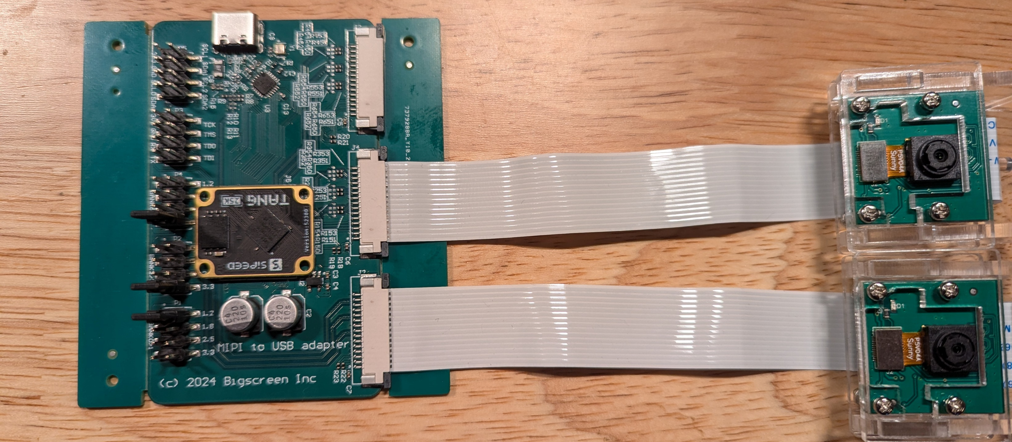
Sipeed Tang Module
GW5A-LV25MG121NES
USB 2.0 PHY Chip
USB3317C
Cam1, Cam2 – connected to GPIO (MIPI IO mode)
15-pin flex cable to Raspberry Pi camera v1 (OV5647)
(Note: not the camera we plan to use for eye tracking)
Cam0 – connected to MIPI Hard PHY

